Slide 1

COSC 340: Software Engineering
Fall 2021
Dr. Austin Henley

Slide 2
Today…
My experience with software engineering?
What is software engineering?
What topics will we cover?
What will you get out of this?
Course structure

Slide 3
Today…
My experience with software engineering?
What is software engineering?
What topics will we cover?
What will you get out of this?
Course structure

Slide 4
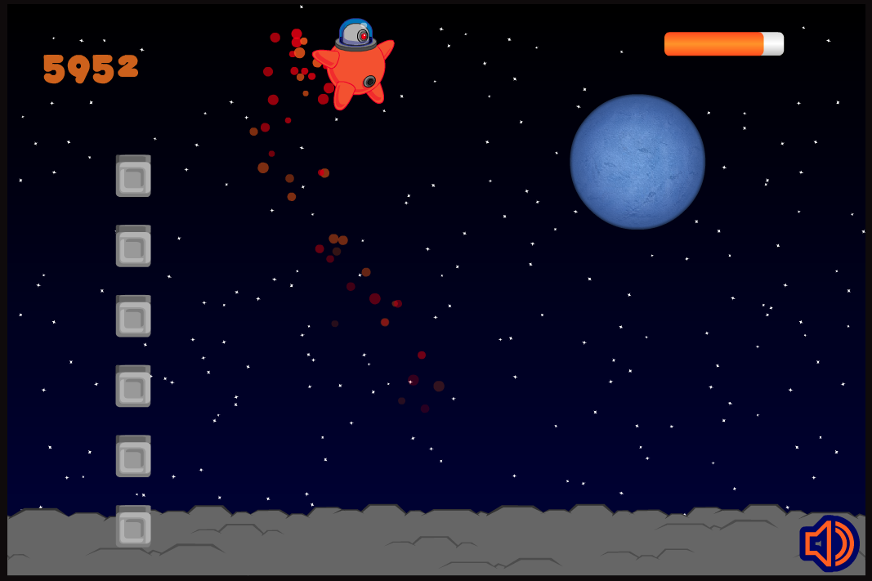
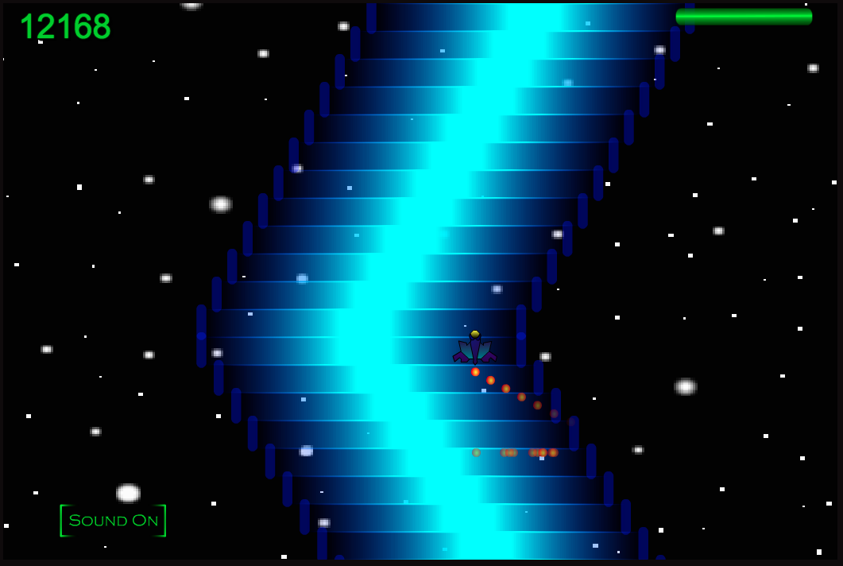
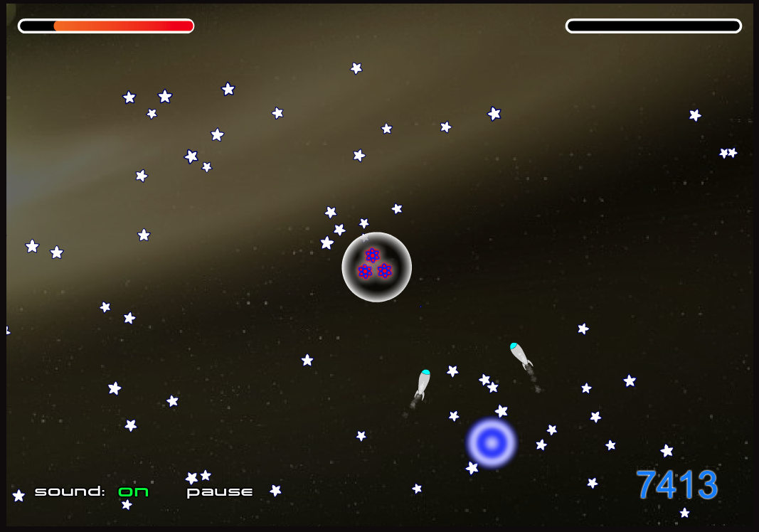
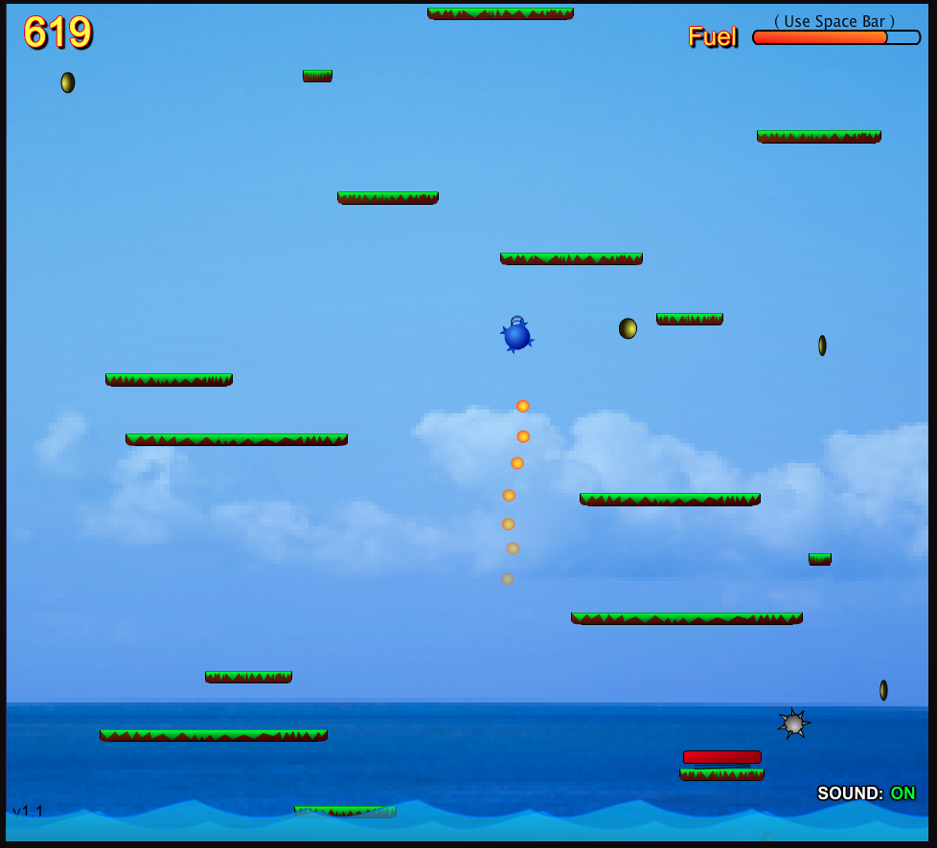
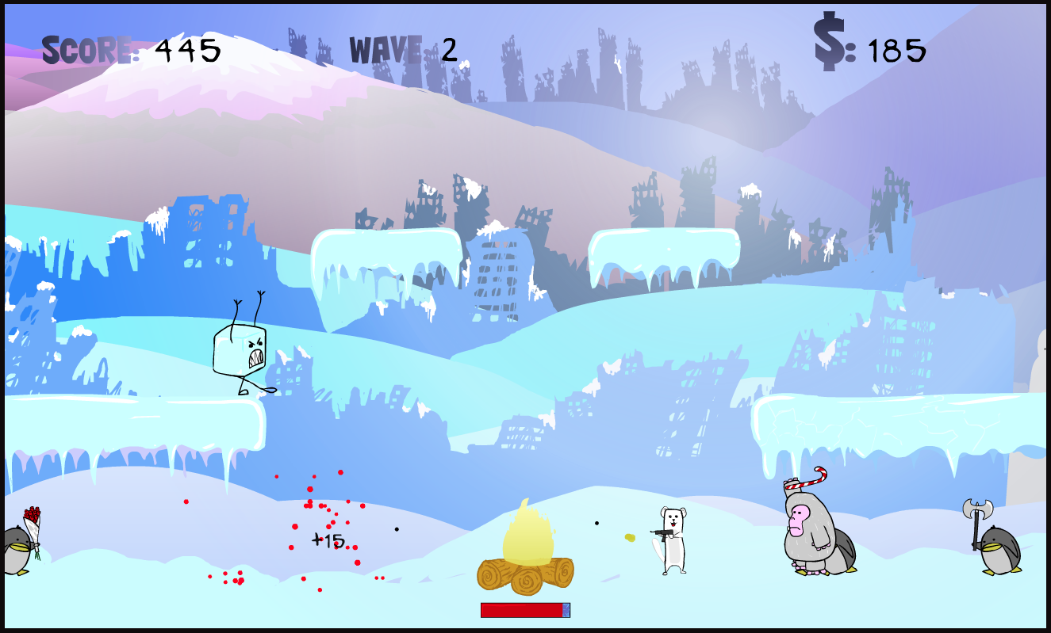
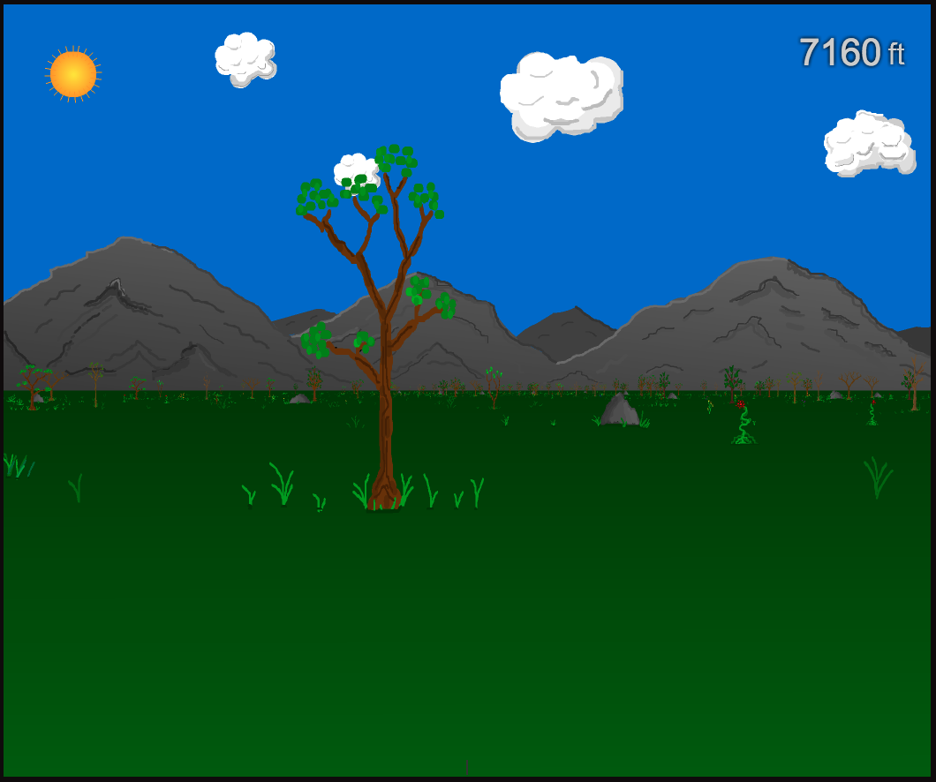
My SE experience
In undergrad, I made $$$ by making games

Slide 5

My SE experience
In grad school, I did 5 internships
Went back to Microsoft 2 years ago

Slide 6
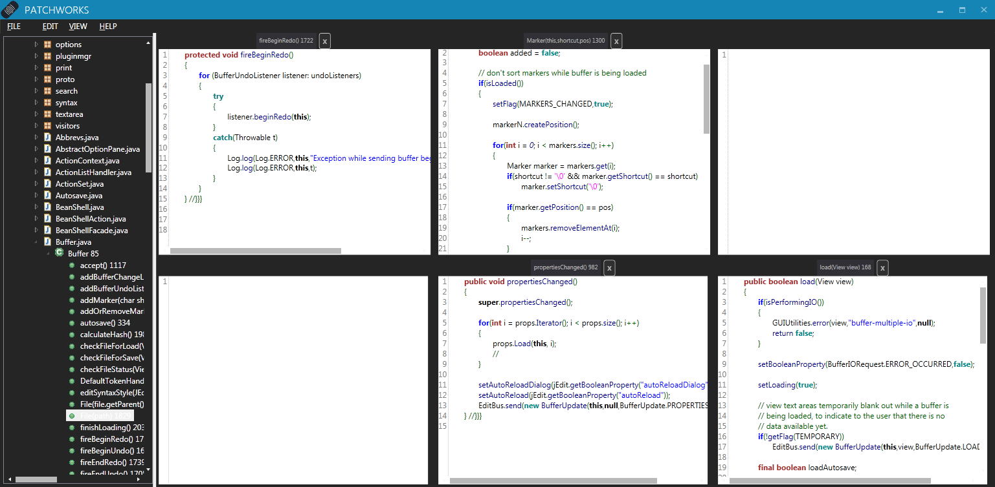
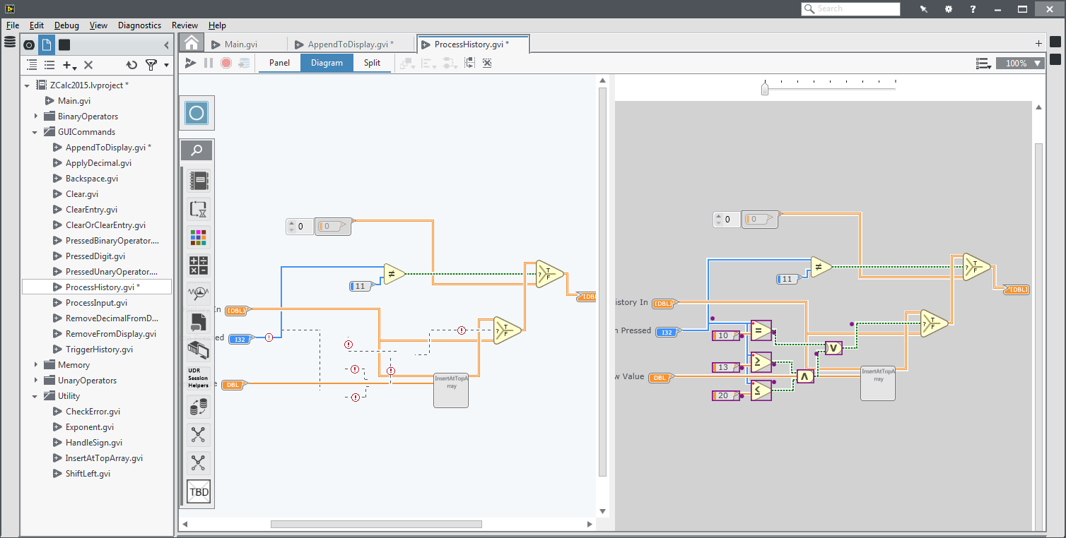
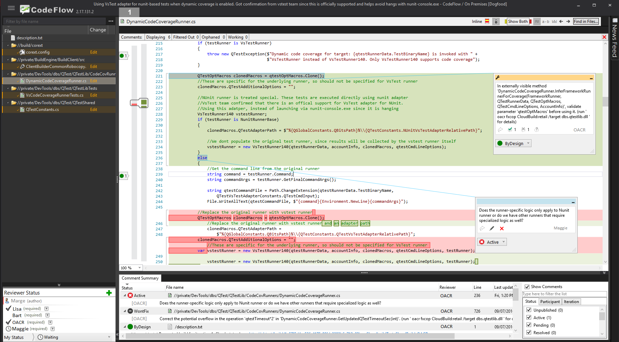
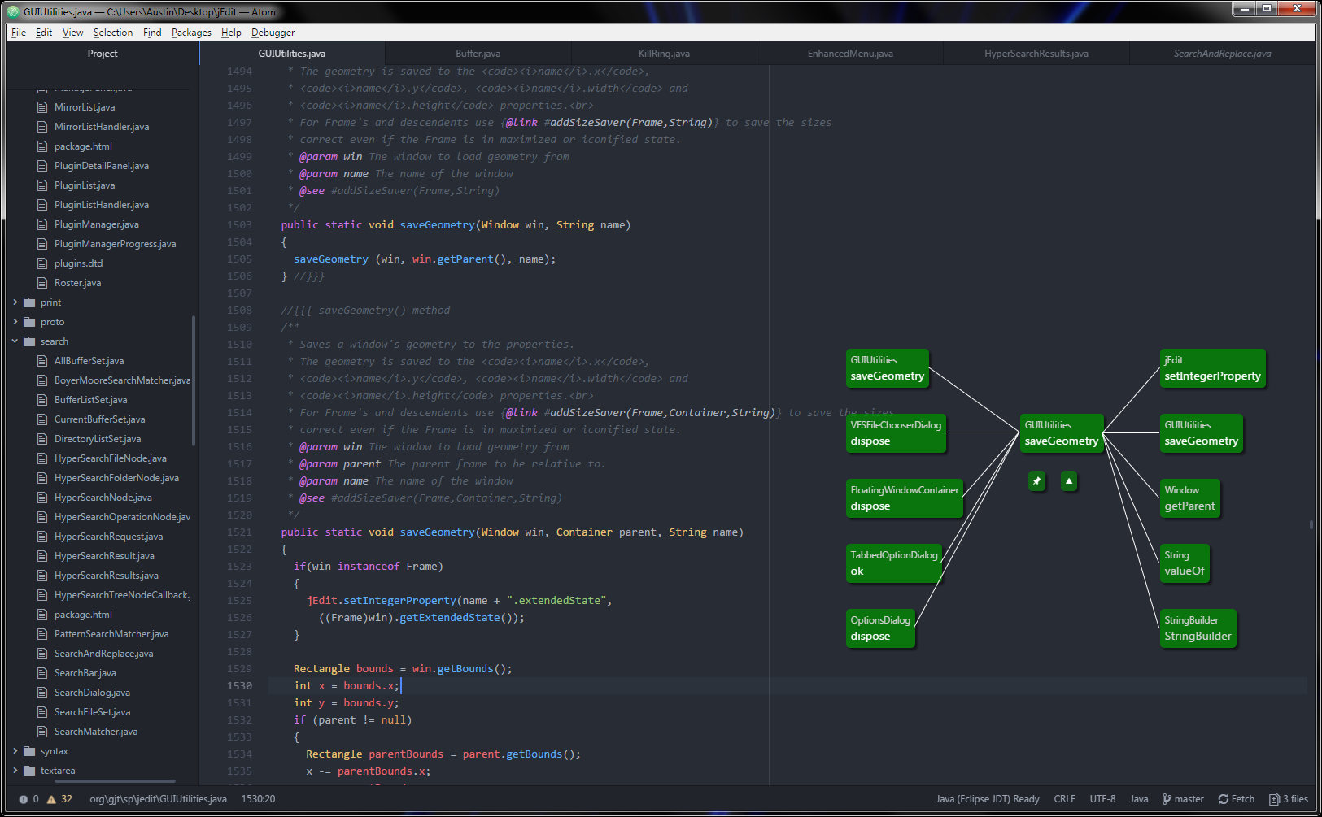
My research
Tools to make software engineers more productive

Slide 7
Survey! What are your experiences?
Internships?
Built anything cool?
Ever build a GUI app?

Slide 8
Today…
My experience with software engineering?
What is software engineering?
What topics will we cover?
What will you get out of this?
Course structure

Slide 9
What is Software Engineering?
Software engineering is the application of a systematic, disciplined, quantifiable approach to the design, development, operation, and maintenance of software, and the study of these approaches; that is, the application of engineering to software.
IEEE’s definition

Slide 10
What is Software Engineering?
Software engineering is what happens to programming when you add time and other programmers.
Russ Cox

Slide 11
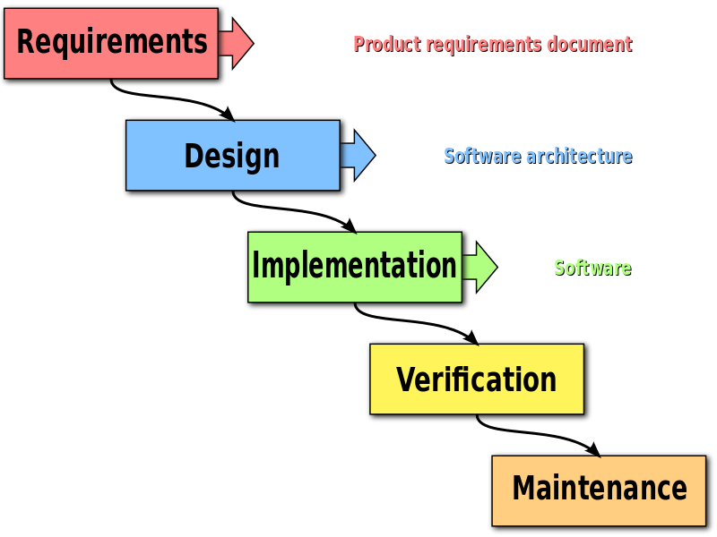
What does SE consist of?
Anything else?
What if things change?
How do you know when each step is “done”?

Slide 12
What does SE consist of?
Maybe in a perfect world
Anything else?
What if things change?
How do you know when each step is “done”?

Slide 13
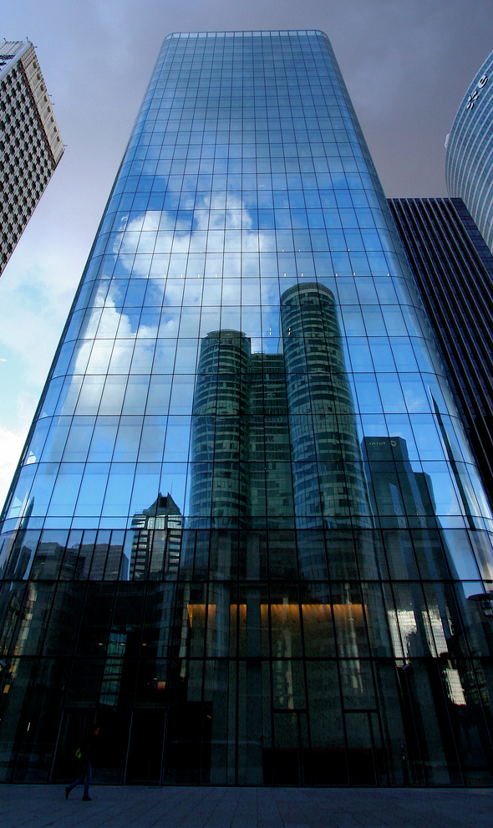
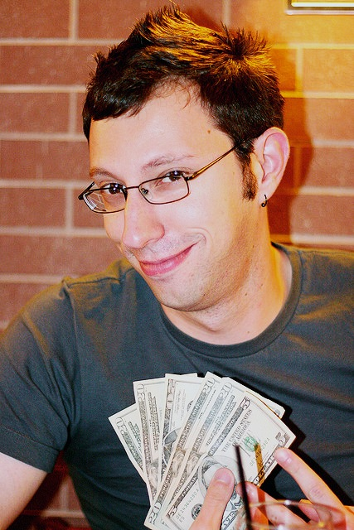
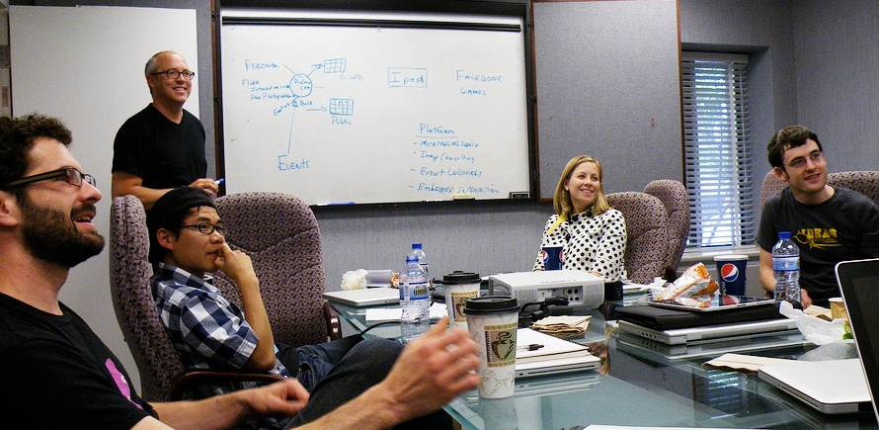
Characteristics of SE Projects
Large Scale
Customers
Teams of Developers
http://flic.kr/p/83MmEP
http://flic.kr/p/hnrKZ
http://flic.kr/p/sAPm8

Slide 14
What is the measure of a successful software engineering project?

Slide 15

What is the measure of a successful software engineering project?
Customer Satisfaction
http://flic.kr/p/hnrKZ
* OK, effect on society and humanity matters too, but humor me…

Slide 16
What do customers want?

Slide 17
What do customers want?
Software that
Meets their needs,
On time,
and
On budget

Slide 18

Unfortunately, satisfying customers is hard…
http://flic.kr/p/7pGoCd
Have you ever been a dissatisfied customer?

Slide 19

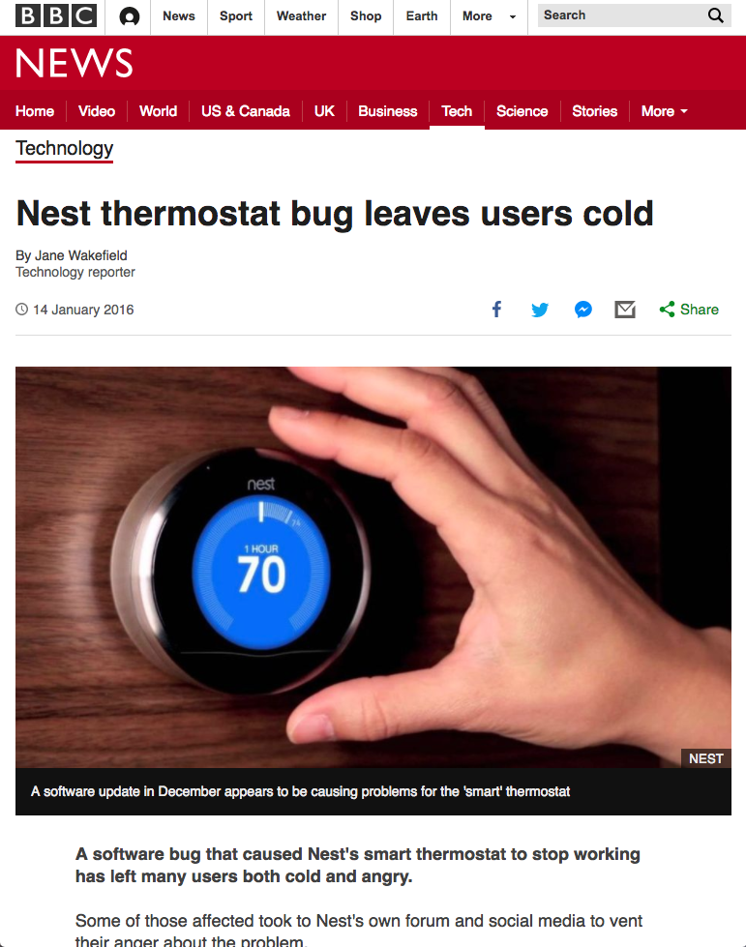
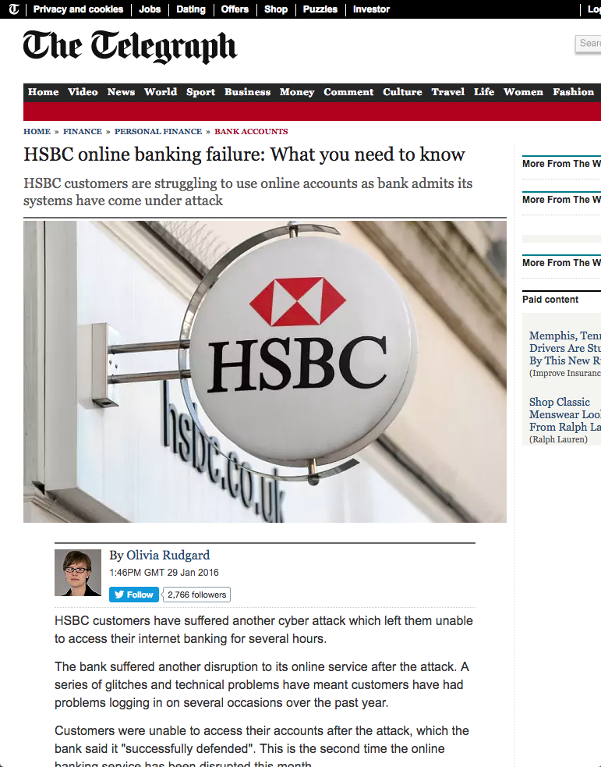
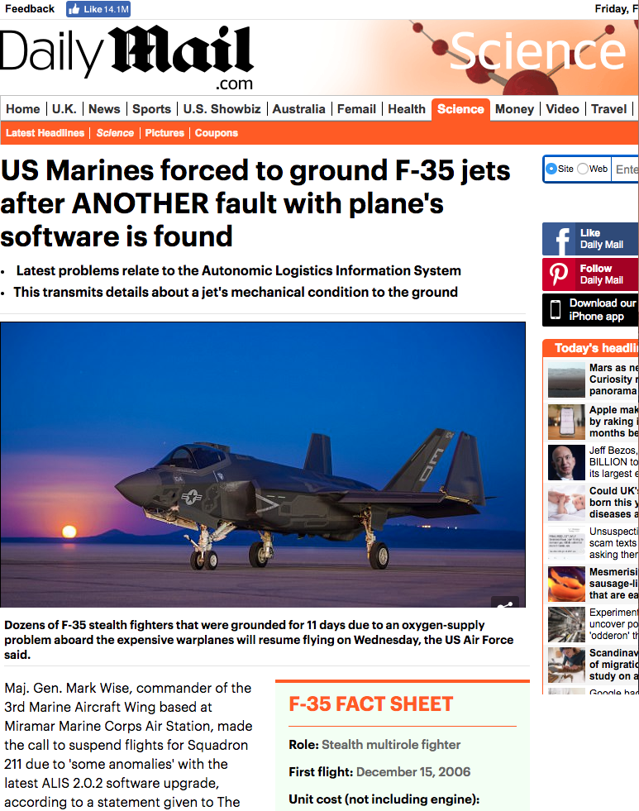
Human error
Software failures cost $1.1 trillion in 2016
[Tricentis ’17]
Notes:
This not only affects businesses, but everyday people as well…

Slide 20
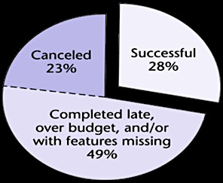
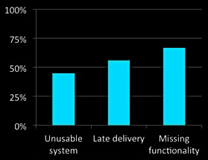
The “Software Crisis”
Since the 1960s
(More like a depression)
Of 28,000 projects completed in 2000…
2002 Study: 78% of orgs landed in court
(Standish Group)
(Cutter Consortium)

Slide 21


Although stats improving, challenges remain…
More headlines (Oct 2013–Aug 2014)
Tech Problems Plague First Day Of Health Exchange Rollout
Health Exchange Tech Problems Point To A Thornier Issue
It's Easy To Blame The Canadians For HealthCare.gov Problems
Sebelius: Hold Me Accountable For HealthCare.gov Debacle
Add Security To The List Of HealthCare.gov Tech Issues
Oregon's State Exchange May Be Worse Than HealthCare.gov
Could A Tech Giant Build A Better Health Exchange? Maybe Not
Official In Charge Of Creating HealthCare.gov Steps Down
Giving Up On Its Obamacare Exchange No Cure For Oregon's Ills
Oregon Sues Oracle For "Abysmal" Healthcare Website
( )
( )

Slide 22
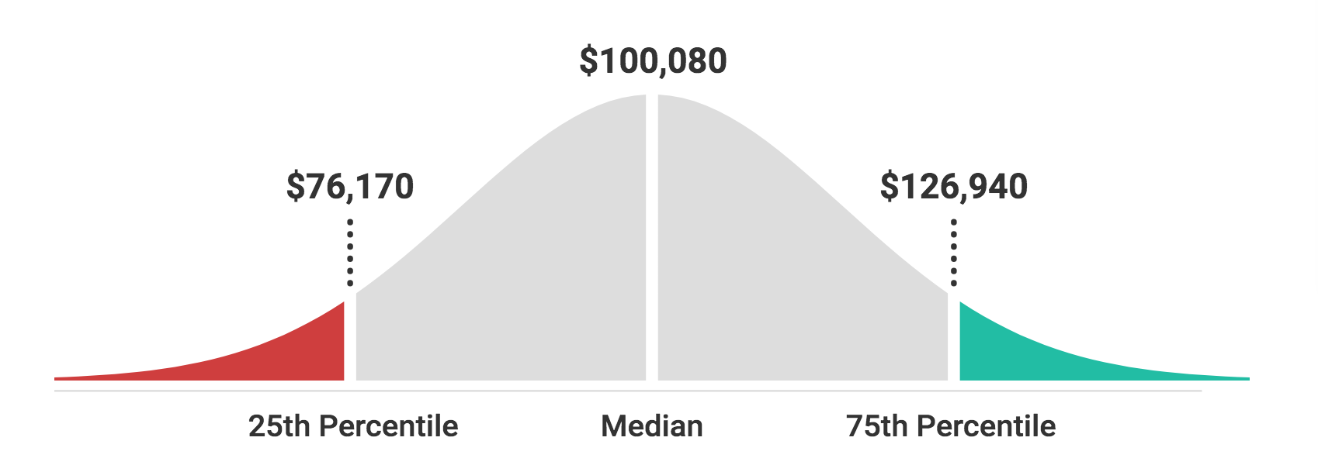
You can help save the world!
New grad? West coast tech will pay over $150k salary+stock
Check http://levels.fyi for more salary info!

Slide 23
Today…
My experience with software engineering
What is software engineering?
What topics will we cover?
What will you get out of this?
Course structure

Slide 24
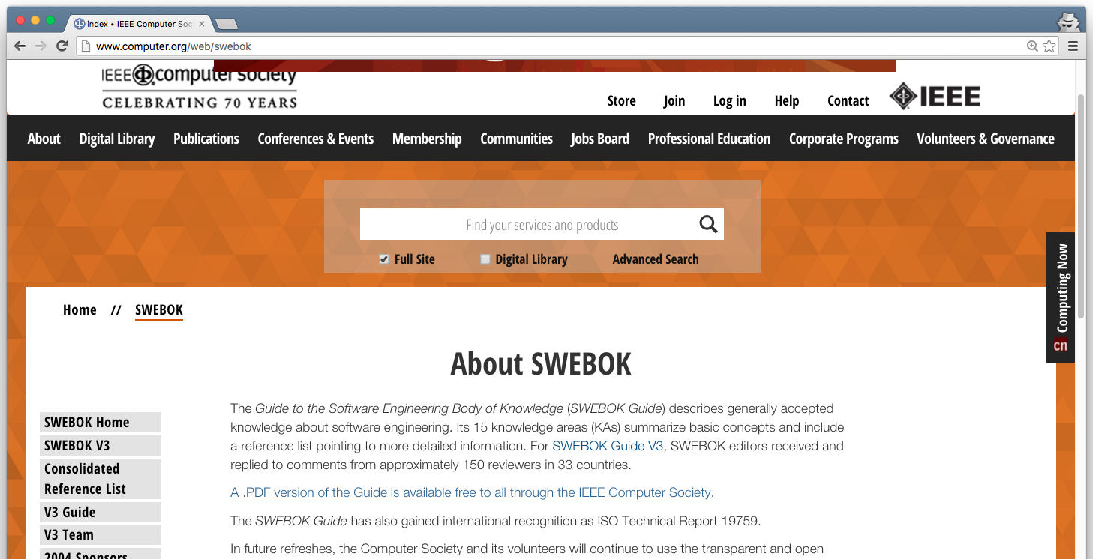
The SWEBOK (pronounced “SWEE-bock”) Software Engineering Body Of Knowledge SWEBOK Guide: http://www.computer.org/web/swebok

Slide 25
15 Knowledge Areas (KAs)
Software Requirements
Software Design
Software Construction
Software Testing
Software Maintenance
Software Configuration Management
Software Engineering Management
Software Engineering Process
Software Engineering Models and Methods
Software Quality
Software Engineering Professional Practice
Software Engineering Economics
Computing Foundations
Mathematical Foundations
Engineering Foundations

Slide 26
15 Knowledge Areas (KAs)
Software Requirements
Software Design
Software Construction
Software Testing
Software Maintenance
Software Configuration Management
Software Engineering Management
Software Engineering Process
Software Engineering Models and Methods
Software Quality
Software Engineering Professional Practice
Software Engineering Economics
Computing Foundations
Mathematical Foundations
Engineering Foundations
We’ll focus on this subset

Slide 27
SE Research
Introduce you to research topics in SE
Examples:
Designing code editors to be easier to use
Identifying and fixing bad code
Proving programs will behave correctly
Efficiently testing code
Mining code repositories

Slide 28
Today…
My experience with software engineering
What is software engineering?
What topics will we cover?
What will you get out of this?
Course structure

Slide 29

Real-world skills and tools
Skills
Documenting requirements
Collaborative development
Implementing GUIs
Usability testing
Code reviewing
Refactoring
Tools
IDE
git and GitHub
Program analyzers
Documentation generators
Unit testing framework
http://flic.kr/p/9DTDXi

Slide 30
Real-world skills and tools
Skills
Documenting requirements
Collaborative development
Implementing GUIs
Usability testing
Code reviewing
Refactoring
Tools
IDE
git and GitHub
Program analyzers
Documentation generators
Unit testing framework
Also: help get you a job
(and be good at it)
http://flic.kr/p/9DTDXi

Slide 31
Today…
My experience with software engineering
What is software engineering?
What topics will we cover?
What will you get out of this?
Course structure

Slide 32
Course Structure
Lectures
In-class activities
We will adjust due to the class size and COVID…
Assigned reading
Quizzes
Group project

Slide 33
Lectures & in-class activities
Lectures will cover…
SE topics
Tutorials on how to use tools
Sometimes will have activities
Meet with your group
Apply the lecture topic (e.g., user stories)
Tangibles will be for a grade! (Don’t skip class…)

Slide 34
Assigned reading & quizzes
Assigned reading
No textbook; I will link to any documents
I’ll try to make these exciting!
Weekly-ish quiz
Covers either lectures, live demos, or reading
Take these individually! No communicating!
Frequent but small

Slide 35
Group project
Main portion of the class!!!
Build an awesome project
Put it on your resume/portfolio
You form a group of 3-5
Build a desktop application
We will be using…
Python, Qt, git, GitHub, VS Code

Slide 36
Project structure
3-4 iterations lasting 2-3 weeks each
Each iteration you propose your individual contribution
I will implement X and Y features
Additional tasks will be assigned
Reviewing someone else’s code
Running program analyzers on your project
Adding unit tests
Milestones
Features completed
Demo

Slide 37
What will you be building???
Stay tuned…

Slide 38
Things for you to do!
Make a GitHub account
Install git, Python 3, VS Code
Think about who you might team with
Nothing due yet

Slide 39
Next week…
First SE lecture
First quiz
Setting up dev environment
More project info

Slide 40
Teaching Assistants
We have two TAs:
Dylan Lee and Ben Klein
They’ll help with live demos, project support, and provide feedback
Their emails are in the syllabus

Slide 41
Let’s tour the course web page & syllabus https://tiny.utk.edu/cosc340

